Slide 1
The ABC Solar Company
Institution
Name
Course

Slide 2
Summary Analysis
Those living in Henderson, Nevada 19.5%.
Percentage of people thinking that having a solar is a good investment 41.5%.
Residential homes planning to install solar 46.3%.
Satisfaction level of those with residential solar:
Very dissatisfied 7.3%.
Dissatisfied 0%.
Neutral 9.8%.
Satisfied 24.4%.
Very dissatisfied 7.3%.
Not applicable51.2%
Notes:
According to the results from the analysis of the results from the survey, the people who participated in the survey and reside in Henderson, Nevada were 19.5%. Those who thought that having installed a solar was a good investment were 41.5% and those were planning to install solar system in the near future accounted for 46.3% of the total number of participants. this is a clear indication that there exists a market gap in Henderson, Nevada which the ABC Solar Company could fill. In addition the number of people who asserted that they were satisfied by the solar products that were installed at their residential homes accounted for only 24.4%. This means that the company take advantage of the remaining percentage of the people and hence fill in the existing market gap and offer top notch services and products.

Slide 3
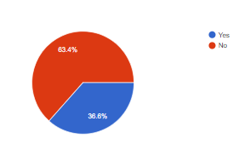
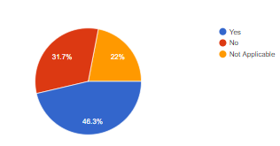
Cont…,
Percentage of residential homes with solar system installed 36.6%.
Percentage of residential homes without rooftop solar products 63.4%
The pie chart on the left represents the percentage of residential homes with rooftop solar products installed.
The pie chart on the right represents the percentage of residential homes which are planning to install rooftop solar products.
Notes:
There is also a substantial percentage of residential homes that indicated that they had no rooftop solar systems installed in their homes. This is a large number of homes meaning that the company could capitalize on this and enter the market within the area.

